Slide 1


Building Blockchain & Cryptocurrency
Version-2
By Hidayatullah ARGHANDABI

Slide 2
Main goal of project
Build a blockchain and cryptocurrency
Understand the technology how it works
Block chain project
Bitcoin and Ethereum how they works.
We will search these technologies and then code our coin.

Slide 3
Roadmap
Code the core block chain
Build an API around the block chain that user can interact.
Create a dynamic peer-to-peer server for multiple contributors.
Implement a proof of work system to balance users.(Proof algorithm)
Create a transaction system for a cryptocurrency
We will create a currency as bitcoin and Ethereum.

Slide 4
Implementation
Building Blocks -DONE
Building Block Chain -DONE
Developing the application -DONE
Create Block chain network and UI -DONE
Proof of Work
Wallets and Transactions on the Blockchain
Collect Transaction in a Pool
Mine Transaction in a Block
Project Submission

Slide 5

Development environment
NodeJS for the project (JavaScript)
Write test as we go along

Slide 6
Preparing the environment
Created a project and enter the project
md sf-chain
cd sf-chain
Add a package.json and initialize
Npm init –y
Installing the nodeman for the project to see the project while developing
nodemon –save-dev

Slide 7
What is Block
Most fundament to power cryptocurrency
To build block chain we need the blocks
Block consist of 4 fundamental data
Timestamp in milliseconds
lastHash –the hash of the block before it
(unique value for a block that is generated based on a combination all of its unique data)
hash-based on it own data (Generated based on its own data)
The data to store (Transction or any other data)
Notes:
We will be using object oriented style

Slide 8
Notes:
3***this data in block can be anything may be array of number
Or a list of transaction between two individuals.

Slide 9
Dev-test.js for the development purpose
Go to the package.json “dev-test”: “nodemon dev-test ”
Notes:
So that your organization can tract its economical history. As a ledger the blockchain servers the purpose of storing the transaction. In fact it is a distributed ledger

Slide 10
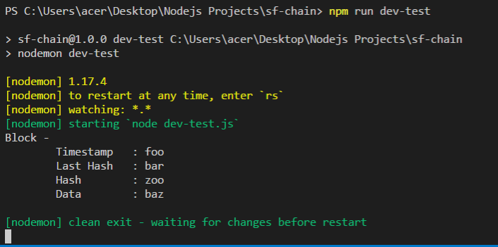
Run the first block

Slide 11
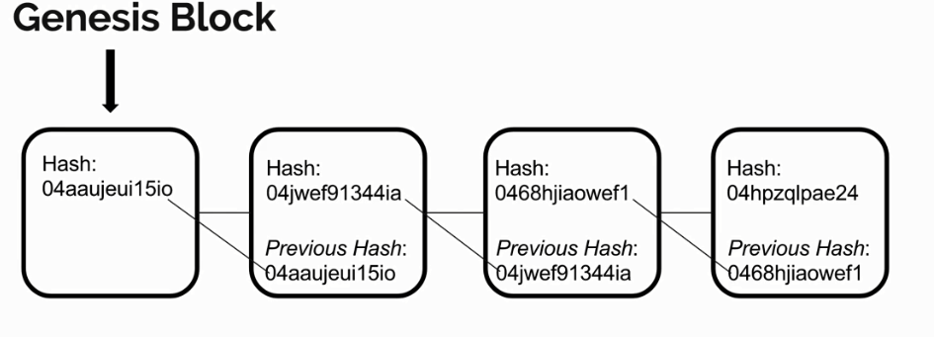
Genesis Block
We defined blockchain as a chain of blocks
Where each block generate a hash value that is calculated from the block came before.
This makes the question for the first block that where the data come from if there is no block before.
Block chains has the concept of the Genesis block

Slide 13
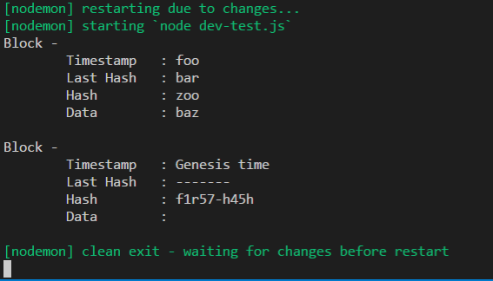
in dev test

Slide 14
Mine block function will also be static, we need a new block instance in order to use this function

Slide 15
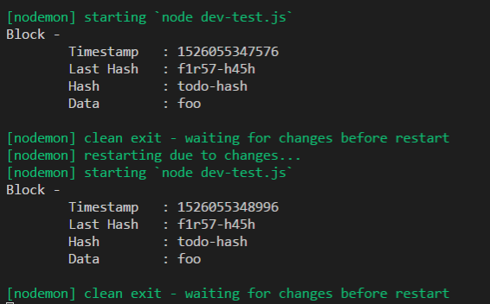
dev-test
Show that we have a successful mine block function. It has a unique timestamp which is a lot of mili-seconds (Note we used the substring method ) almost 50 years ago

Slide 16
SHA256 Hash Function
hash is generated from the timestamp, last Hash and the store data.
For the unique hash value we will use the unique algorithm called SHA-256,
which stands for secure H Algorithm-256. (32 characters) will be generated to represent the Hash, hashing algorithms properties:
Even if one character changes in the original data SHA-256 algorithm will produce an entire unique string of characters for a different hash but it will always produce the same hash with given data.
One-way hash function, it is impossible to decrypt that hash and get the data back. It only works one way from the direction of the data to the hash. This is useful when we come to the
Useful for block validation, we can immediately know if the data has temper with, if it generated data is different from one that we create given the data that is in the block.
Adding new model name crypto-js contain an SHA-256 function that we can use,
Npm i crypto-js –save

Slide 17
created the hash function and equalize hash constant in the mine block to the hash function that uses the SHA-256 algorithms from the crypto-js module.
Run the dev-test and check the result

Slide 18


Slide 19
Block.test.js
Go to package.json and change the test to the jest

Slide 20
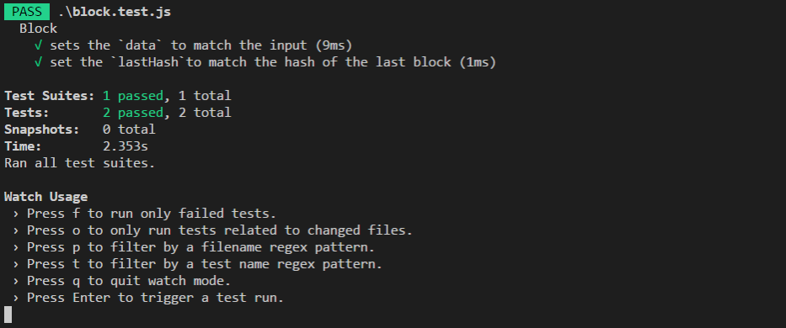
From terminal Npm run test

Slide 21
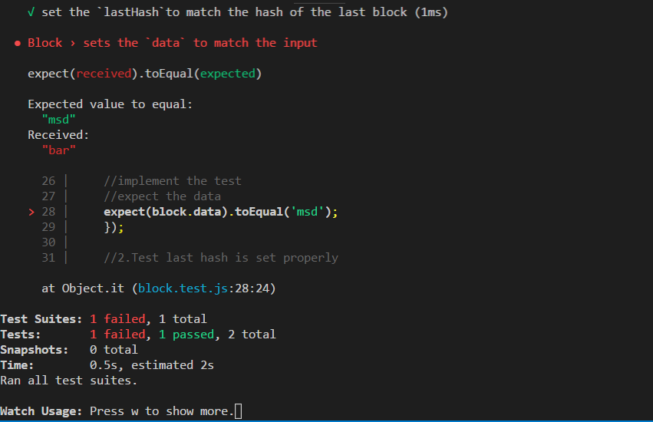

Slide 22
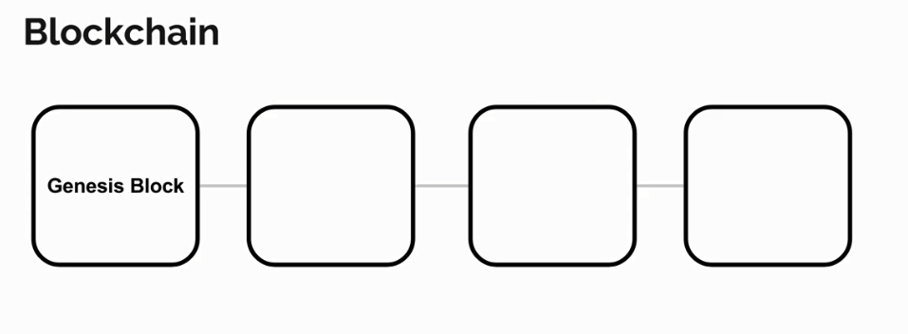
Block Chain
Chain is an array of block,
First block is the genesis block. It has the ability to add a block to the chain and added to the end of its block.
New block is created based on the last block. By doing this it creates link across the chain.

Slide 23
Create new File Block.js

Slide 24
Create the blockchain.test.js file in the root folder

Slide 25
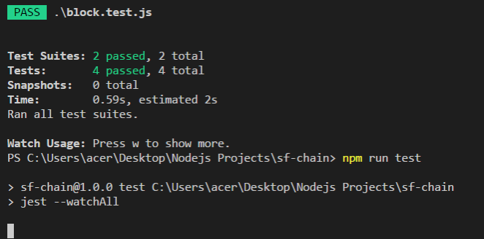
And run the test from terminal

Slide 26
Multiple chain Validation
Extend to multiple contributors
Each miner will have their own version of the chain
When miners add a new block to the chain, they will have to submit that new block for the other chain in the system to accept that in order to update the overall system so that way everyone gets an updated copy with that new block loaded in.
So all the changes are consistent. How ever for other miners to accept the changes there need to be some validation to make sure that new block is valid and that they should actually accept.

Slide 27
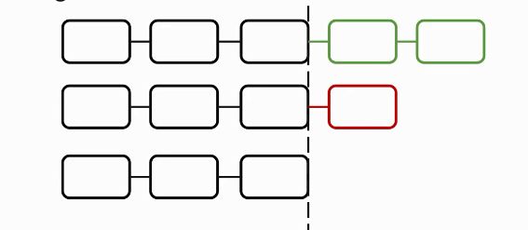
Longer Chains
Three block chains one miner add two and an other miner add one. Accepting longer chains come in that block chain system can ensure that the agreed upon the change for everyone is always the one that has the most data with in it.

Slide 28
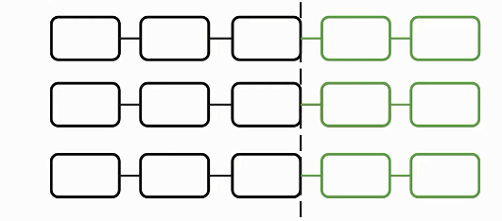
This also produces a situation which result a problem of forks in the chain

Slide 29
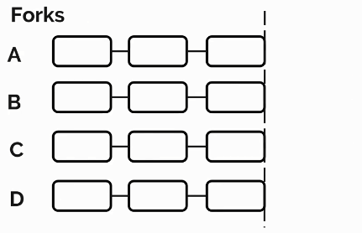
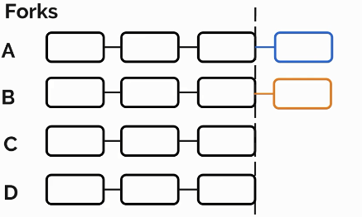
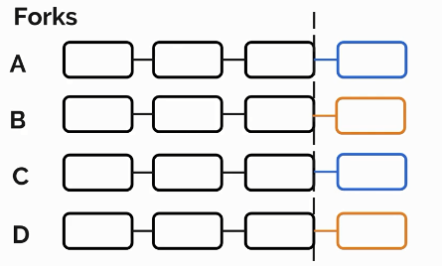
Miner a add a block and miner b add a block
Creating a fork in the system based on the last block

Slide 30
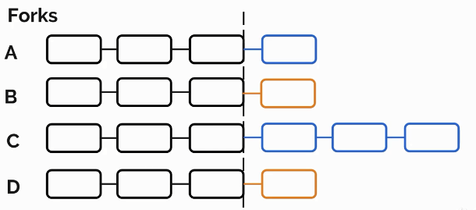
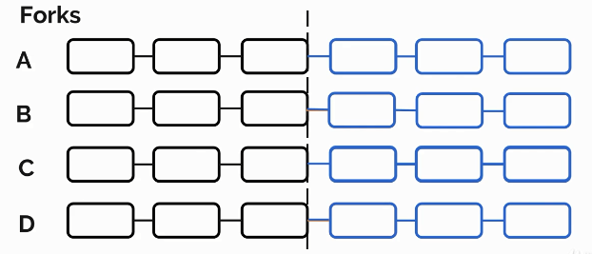
Says a miner extend upon a miner change. This chain now longer than everyone chain in the system. Therefore everyone have to accept the Long chain.
Now fork is resolved by accepting the original block submitted by miner A. this not means block chain which had the block from miner B will lose that original block data. The block can be added to the newly received chain.

Slide 31
Hash Validation:
This validation is check the hash value produced by each chain of the block,
so every block chain has the access to hash function which generate the hash base of the block data.
When a block chain receive a change it can ensure that this hash is regenerated by regenerating this hash itself.
If the hashes don’t match data might probably temped with therefore the block chain will decide not accept the new change.
Adding a fuction that will check the Chain that does the job of validating the chain . If the chain is invalid the function will return false, otherwise the chain is okay the function returns True.
In block chain js we add is valid method

Slide 35
the jest
Our goal is to add multiple collaborators to the block.
We added the validation method for the chain to validate the chain
the actual function that replaces the chain with incoming block chain if it is valid. So we will the function replace change in the blockchain.js

Slide 36
Thank You

